Slide 1
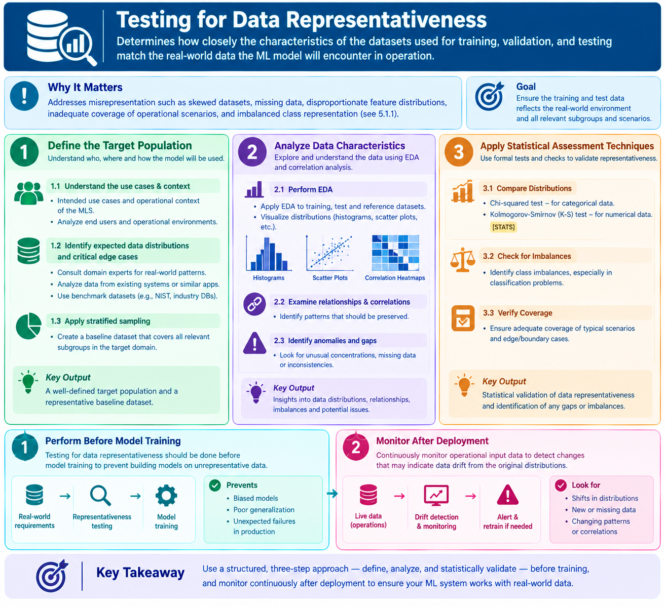
5.1.4 Testing for Data Representativeness

Slide 2
5.1.4 Testing for Data Representativeness
5.1.4 Testing for Data Representativeness
Data representativeness testing determines how closely the characteristics of datasets used for training, validation, and testing Machine Learning (ML) models match the real-world data that the model will encounter during operation.
The objective of this testing is to ensure that the datasets accurately represent the target population and real-world operating conditions.
Data representativeness testing helps identify issues such as:
Skewed Datasets: Data that is biased toward certain groups or characteristics.
Missing Data: Important information or records that are absent from the dataset.
Disproportionate Feature Distributions: Certain feature values appearing too frequently or too rarely.
Inadequate Scenario Coverage: Insufficient representation of real-world situations, including unusual or boundary conditions.
Imbalanced Class Representation: Some classes having significantly more samples than others (see Section 5.1.1).

Slide 3
5.1.4 Testing for Data Representativeness
Steps Involved in Testing for Data Representativeness
Define the Target Population
The first step is to identify and understand the target population for which the Machine Learning System (MLS) is being developed.
This involves understanding the intended use cases, operational environment, and characteristics of the users who will interact with the system.
The following activities are performed:
a. Understand the Operational Context
Identify the intended use cases of the ML system and understand the environment in which it will operate.
b. Analyze End Users and Operational Environments
Study the characteristics of the target users and the different operating conditions under which the ML model will be used.
c. Identify Expected Data Distributions and Edge Cases
Determine the types of data that the system is expected to receive during real-world operation.
This can be achieved by:
Consulting domain experts to understand real-world data patterns.
Analyzing data collected from existing systems or similar applications.
Using benchmark datasets from trusted sources, such as NIST and industry databases.
d. Apply Stratified Sampling
Use stratified sampling on representative reference data to create a baseline dataset that includes all relevant subgroups of the target population.
Stratified sampling helps ensure that important groups are adequately represented in the reference dataset.

Slide 4
5.1.4 Testing for Data Representativeness
2. Analyze Data Characteristics
The next step is to examine the characteristics of the datasets and compare them with the expected operational data.
Exploratory Data Analysis (EDA) (see Section 3.2.1) is used to understand the structure, distribution, and relationships within the data.
The following activities are performed:
a. Perform EDA on Training and Test Datasets
Analyze the datasets used for training and testing to understand their characteristics and identify possible representativeness issues.
b. Analyze the Reference Dataset
Examine a reference dataset that represents the expected real-world operational data.
This dataset serves as a baseline for comparing training, validation, and testing datasets.
c. Visualize Data Distributions
Use graphical techniques such as histograms, scatter plots, and other visualization methods to understand how data values are distributed.
These visualizations help identify differences between the ML datasets and the reference dataset.
d. Examine Feature Relationships and Correlations
Analyze relationships between different features to identify important patterns and correlations.
Verify that these relationships are appropriately preserved in the datasets used for model development.
e. Identify Anomalies and Data Gaps
Identify missing information, unusual data concentrations, unexpected patterns, and underrepresented groups that may affect the model's performance.

Slide 5
5.1.4 Testing for Data Representativeness
3. Apply Statistical Assessment Techniques
Statistical assessment techniques are used to determine whether the training, validation, and testing datasets adequately represent the expected operational data.
The following techniques can be applied:
a. Chi-Squared Test
The Chi-squared test is used to compare distributions of categorical data.
For example, it can help determine whether the proportions of different customer categories in the training dataset differ significantly from those in the operational reference dataset.
b. Kolmogorov-Smirnov (KS) Test
The Kolmogorov-Smirnov test is used to compare numerical data distributions.
For example, it can help identify whether the age distribution in the training dataset differs from the age distribution expected in the real-world operational environment.
c. Check for Data Imbalance
Analyze datasets to identify imbalances, particularly in classification problems.
Verify whether important classes are adequately represented so that the model can learn patterns across different categories.
d. Verify Scenario and Boundary Coverage
Ensure that the dataset contains sufficient examples of both common operational scenarios and critical edge or boundary cases.
This helps evaluate whether the ML model can perform reliably under different real-world conditions.

Slide 6
5.1.4 Testing for Data Representativeness
5. Continuous Monitoring After Deployment
Data representativeness testing should continue after the ML model is deployed into production.
The characteristics of incoming operational data should be continuously monitored to identify changes in data distributions.
These changes may indicate data drift, where real-world input data begins to differ from the data originally used to train the model.
Data drift testing is discussed in Section 6.1.7.

Slide 7
5.1.4 Testing for Data Representativeness
Summary of Data Representativeness Testing
Step | Purpose
Define Target Population | Identify the intended users, operating conditions, and expected data
Apply Stratified Sampling | Ensure relevant subgroups are represented
Perform EDA | Analyze and visualize dataset characteristics
Examine Feature Correlations | Verify relationships between features
Identify Anomalies | Detect missing data, unusual patterns, and gaps
Apply Statistical Tests | Compare dataset distributions statistically
Check Data Imbalance | Verify adequate representation of different classes
Verify Scenario Coverage | Ensure typical and edge cases are represented
Test Before Training | Prevent models from learning from unrepresentative datasets
Monitor After Deployment | Detect changes in operational data and potential data drift

Slide 8
5.1.4 Testing for Data Representativeness
Simple Example: Loan Approval ML System
Suppose a bank develops a Machine Learning model to approve or reject loan applications.
The training dataset contains the following age distribution:
Training data vs. expected operational data
Illustrative example of mismatched age-group proportions in training versus operational data.

Slide 9
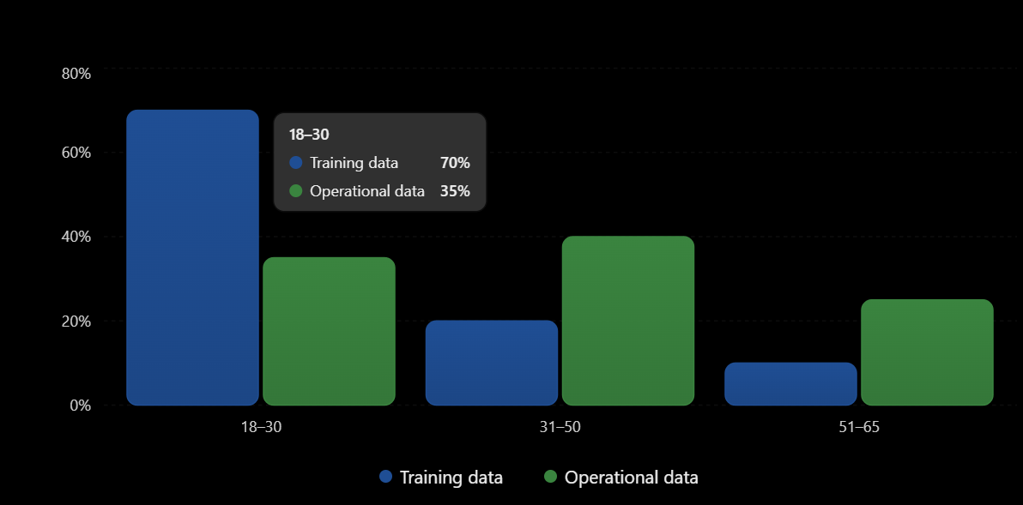
5.1.4 Testing for Data Representativeness

Slide 10
5.1.4 Testing for Data Representativeness
In this example, the training dataset contains 70% applicants aged 18–30, whereas this group represents only 35% of the expected operational population.
This indicates that the training dataset is not adequately representative of real-world applicants.
Testing approach: Use EDA to compare age distributions, apply appropriate statistical tests, and improve the dataset using representative sampling or additional data collection.
Key Takeaway: Data representativeness testing ensures that training, validation, and testing datasets accurately reflect real-world operational data. It helps identify skewed distributions, missing information, class imbalances, and insufficient scenario coverage before model training, while continuous monitoring helps detect data drift after deployment.

Slide 11
THANK YOU!!!

